Slide 1

Comprehensive Design and Analysis Project
IT4010 | 2021
Enhancing
Online Teaching & Learning Experience
by Using
Multiuser Virtual Environment
2021-065

Slide 2


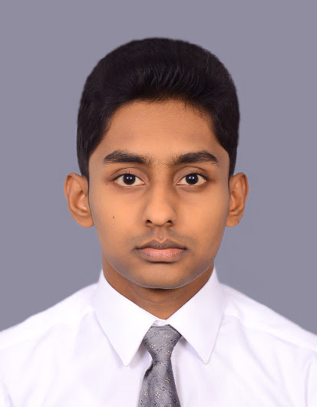
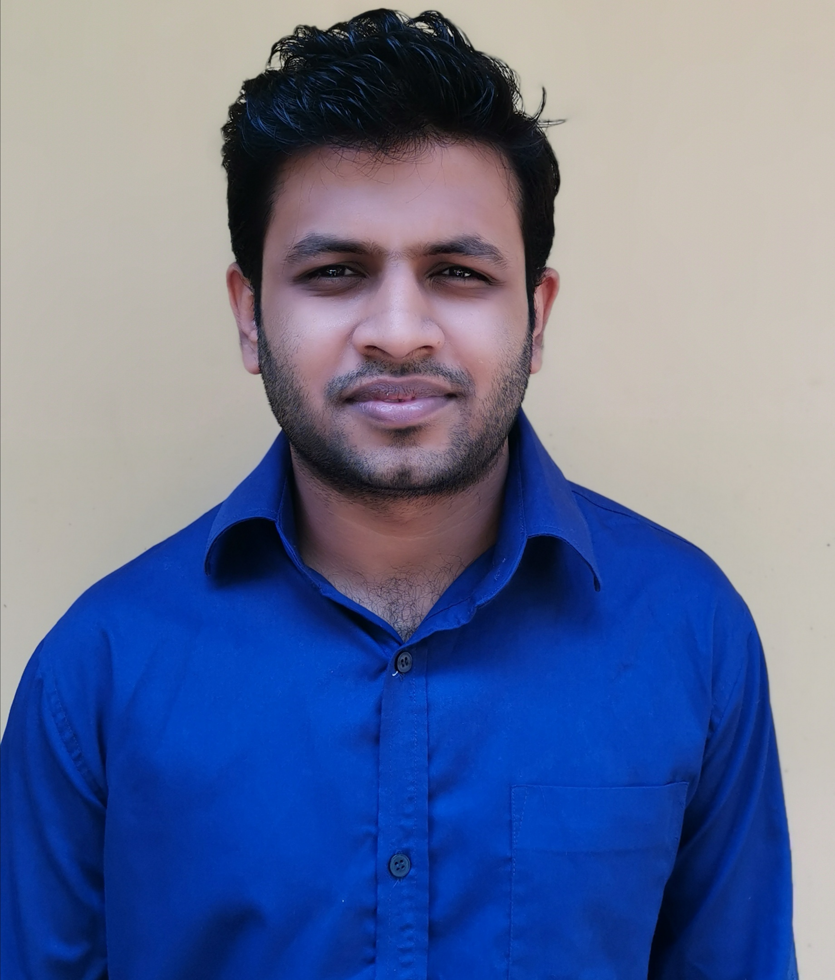
Our Team
Supervisor | Dr. Nuwan Kodagoda
Co-supervisor | Ms. Kushnara Suriyawansa
IT18006544
IT18001112
IT18009132
IT18007848
Perera H.D.D.S
Tharaka W.C.M.K.
Dilanka R.M.T.
Rathnayake R.H.C.S.

Slide 3
IT18006544
Perera H.D.D.S.
B.Sc. (Hons) Degree in Information Technology Specialization in Software Engineering
01

Slide 4
Introduction to Overall project
IT18006544
Effect of Covid-19 in education sector
Perera H.D.D.S
Since video conferencing tools are not intended for teaching and learning purposes, overall learning and teaching experience has become less productive
Shared questionnaire among undergraduate
02

Slide 5
Objectives
Main Objective
IT18006544
Perera H.D.D.S
Enhancing Online Teaching and Learning Experience.
Sub Objective 1
Analyzing the students’ attentiveness to the lecture and help them to keep their attention.
Sub Objective 2
Reducing students' isolation during online lectures and enabling the collaborative learning using multiuser virtual learning environment.
Sub Objective 3
Providing a near-real time, simulated student behavioural view of the students.
Sub Objective 4
03
Help students by providing well-organized lecture note using optimized lecture transcription and related visual figures of the lecture

Slide 6
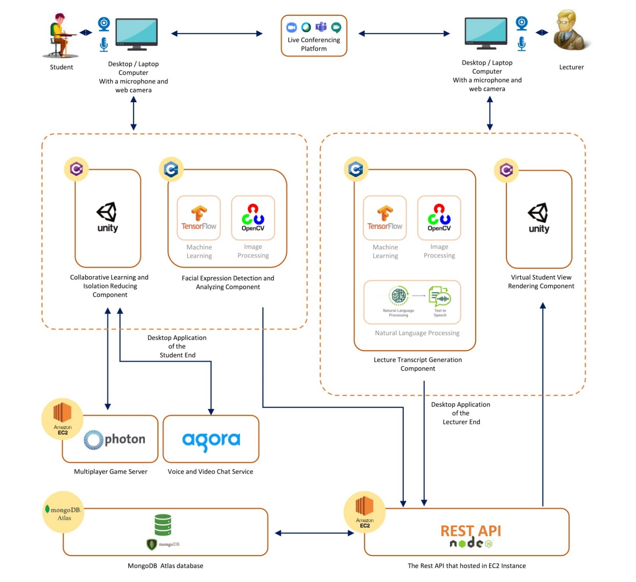
Overall System Diagram
IT18006544
Perera H.D.D.S
04

Slide 7

Research Question
IT18006544
How to enhance online learning and teaching experience ?
Perera H.D.D.S
05

Slide 8
SUB OBJECTIVE - 01
Analyzing the students’ attentiveness to the lecture and help them to keep their attention
06

Slide 9
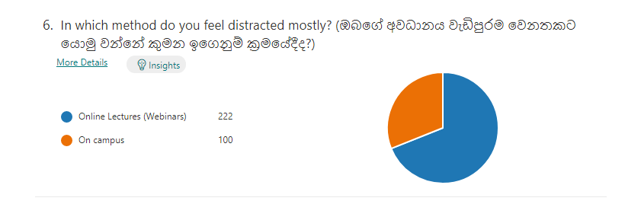
Background and Research Gap
Background
IT18006544
Perera H.D.D.S
Online lectures are new to student.
Remoteness of lecturer and student.
Lack of interactions between student and lecturer when compared to face-to-face lectures.
Students feel more distracted and bored during online lectures.
07

Slide 10

Background and Research Gap
Research Gap
IT18006544
Perera H.D.D.S
Commercial applications such as MS Teams, Zoom, Cisco WebEx doesn’t have a proper way to track student's attention and focus level.
Student notification regarding their individual focus level.
Lecturer notification regarding overall class focus level.
Capture student distractions.
Suggesting lecturer different methods to improve focus level.
08

Slide 11
Research Question
How to capture student attention level during Online lectures ?
IT18006544
Perera H.D.D.S
How to improve student attention level during online lectures ?
09

Slide 12
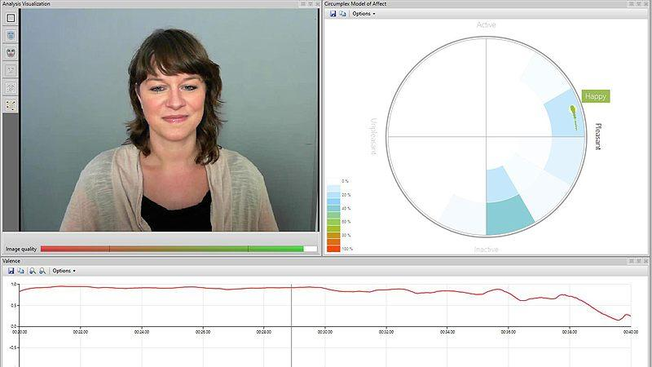
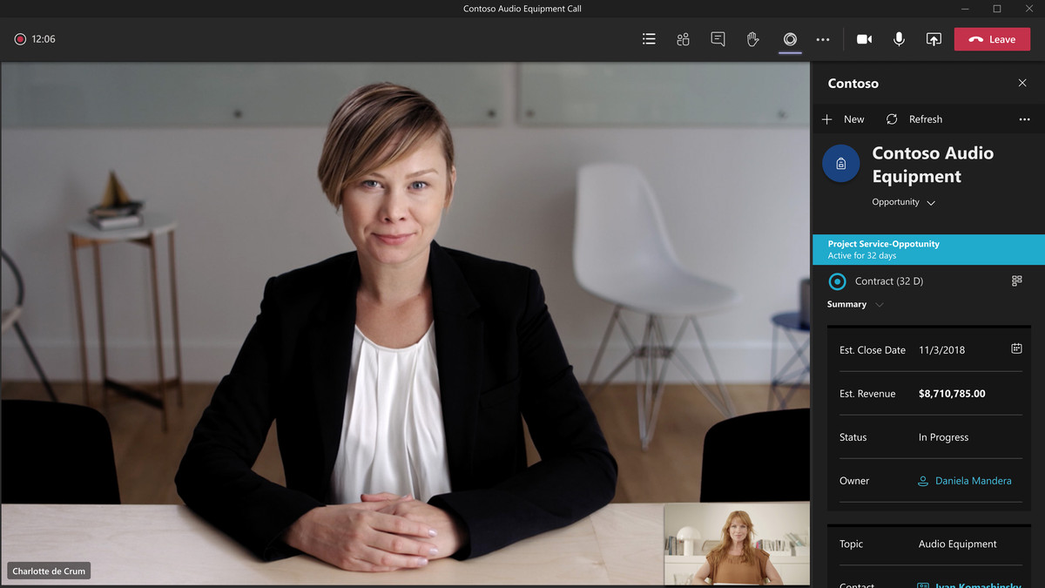
Existing Systems
Face Reader
MS Teams
IT18006544
Perera H.D.D.S
10

Slide 13
Objectives to be achieved
Use of deep learning models to train and capture student’s facial emotion
IT18006544
Perera H.D.D.S
Capture distractive activities of students
Use of edge computing technique to analyze the captured emotions
Optimized algorithm to provide feedback to students periodically.
11

Slide 14
System, Software and Personnel Requirements
System Functional Requirements of the Project
IT18006544
Perera H.D.D.S
Capturing and analyzing student’s attention through facial emotions.
Suggesting methods for lecturer to increase student attentiveness
Periodically notifying student about their attentiveness
Capturing distractive actions by students.
System Non-Functional Requirements
Security
Performance
12

Slide 15

System, Software and Personnel Requirements Contd.
Development Resources
IT18006544
Perera H.D.D.S
Mr. Shan Li - Requested and obtained datasets for facial emotions.
Mr. Palinda Attanayake - Tech Lead at Ustock Trade.
13

Slide 16
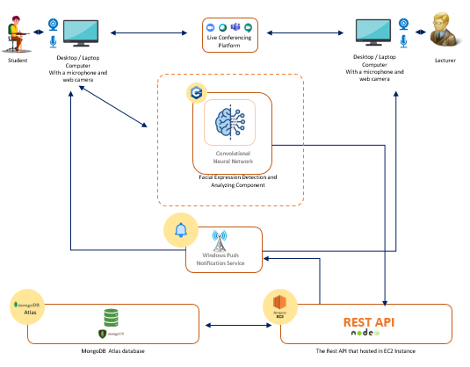
System Architecture
System Architecture Diagram
IT18006544
Perera H.D.D.S
14

Slide 17
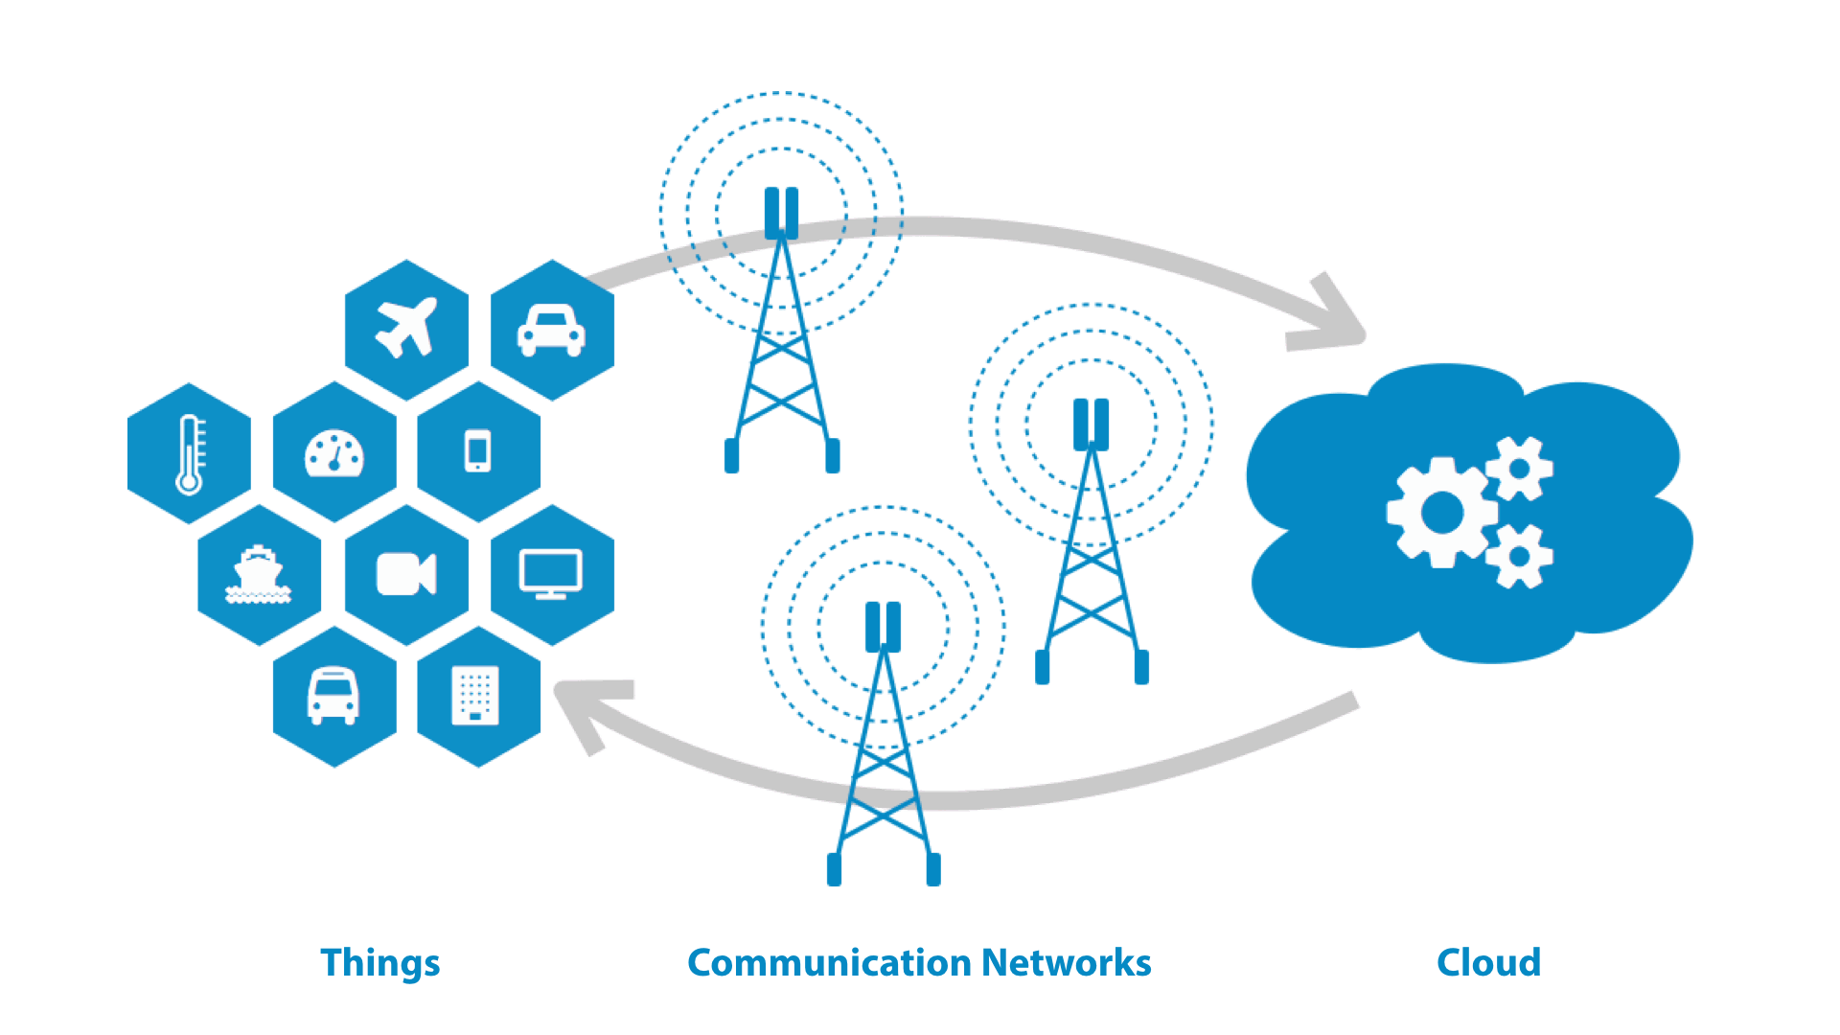
System Architecture
Why edge computing architecture over Cloud Computing ?
IT18006544
Perera H.D.D.S
Privacy and Security
Reduce bandwidth
Reduce server workload
15

Slide 18
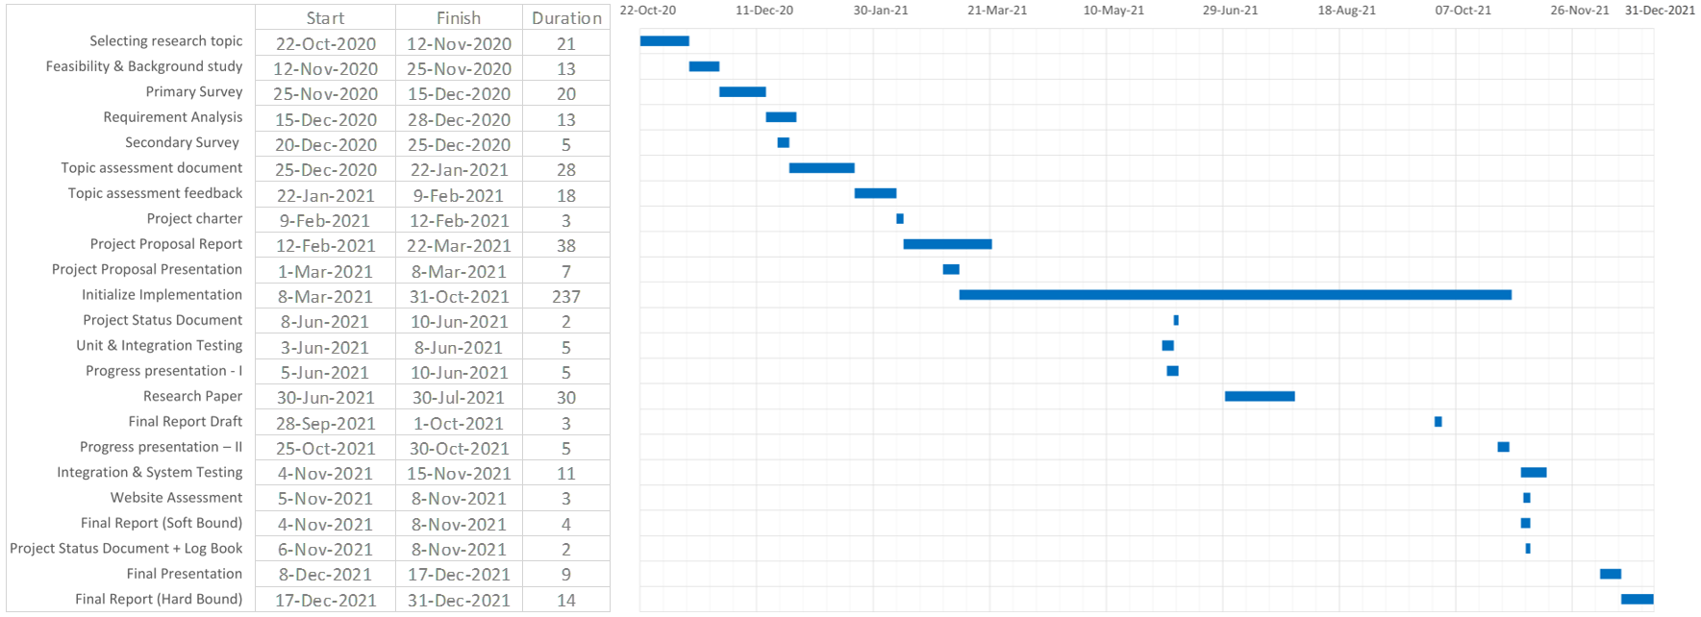
Gantt Chart
IT18006544
Perera H.D.D.S
16

Slide 19

Technologies to be used
C++
IT18006544
Node JS / Express JS
Perera H.D.D.S
AWS EC2 Instance
Google Collab
Window Push Notification Service
Convolutional Neural Network
Python
17

Slide 20

Budget
Component | Amount (USD) | Amount (LKR)
AWS EC2 Instance | 20 | 3,920
Internet Cost | 10.21 | 2000
Total Cost | 30.21 | 5920
IT18006544
Perera H.D.D.S
18

Slide 21
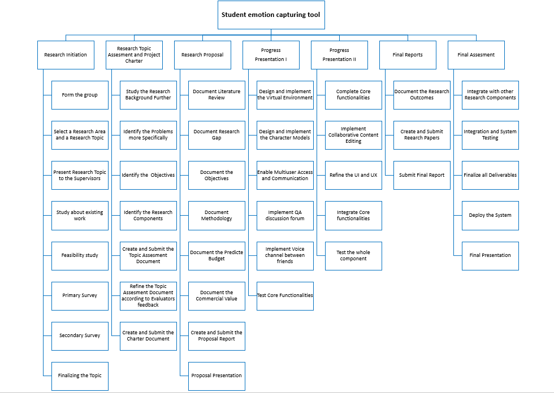
Work Breakdown Structure
IT18006544
Perera H.D.D.S
19

Slide 22
SUB OBJECTIVE - 02
Reducing students' isolation during online lectures and enabling the collaborative learning using multiuser virtual learning environment
20

Slide 23
IT18001112
Tharaka W.C.M.K.
B.Sc. (Hons) Degree in Information Technology Specialization in Software Engineering
21

Slide 24

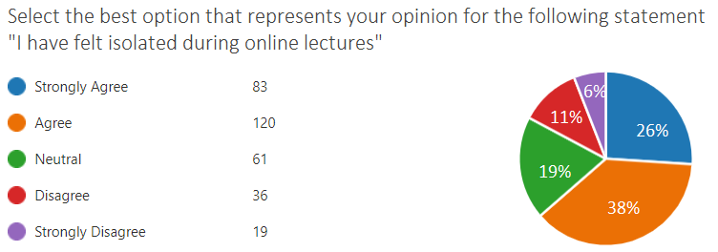
Background and Research Gap
Previous situation: Students were studying together
IT18001112
Tharaka
W.C.M.K.
Present situation: Students are studying remotely
Collaborative learning
Participation Metaphor [1]
Benefits of Collaborative learning [2]
Students feel isolated in the online lecture delivery [3]
Increased interaction between students [3]
Increased interaction is a Stress Reliever [4]
22

Slide 25
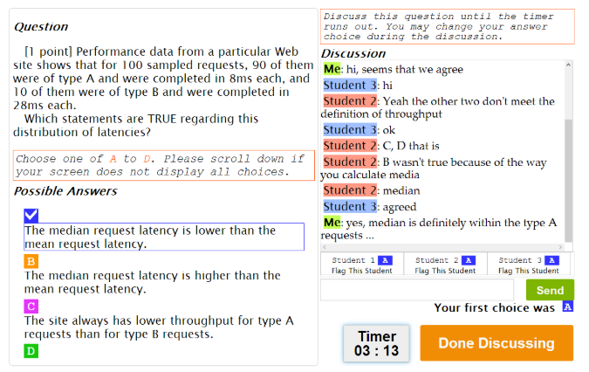
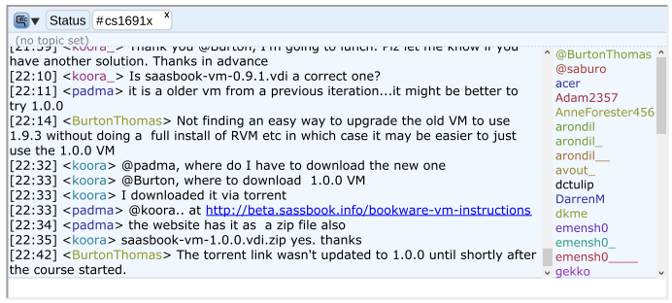
Existing Solutions
IT18001112
Group Discussions in MOOCs [5]
Chatrooms in MOOCs [6]
Tharaka
W.C.M.K.
23

Slide 26
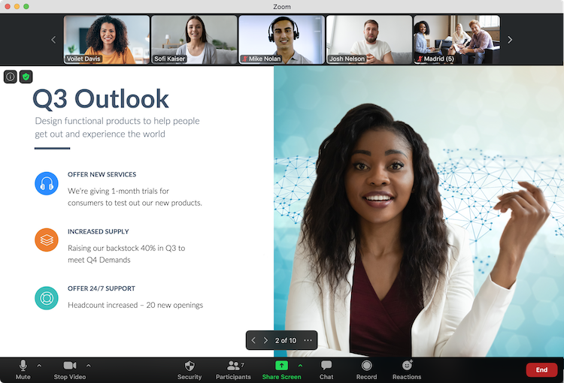
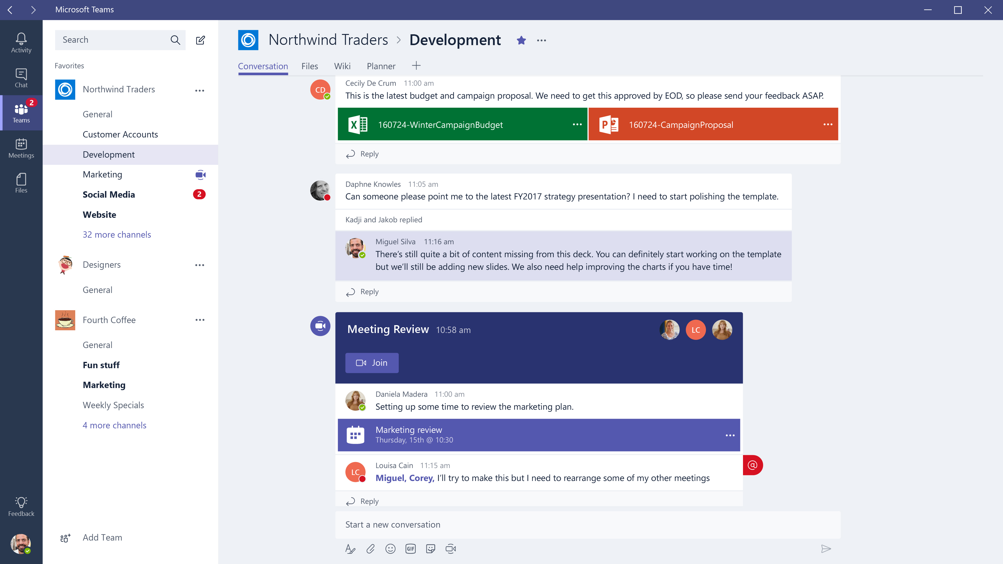
Existing Solutions
IT18001112
Zoom Application
Microsoft Teams Application
Tharaka
W.C.M.K.
24

Slide 27
Research Question
IT18001112
How to enable the Collaborative Learning in an efficient manner
while students are not in same place?
Tharaka
W.C.M.K.
How to reduce student isolation during online lectures?
25

Slide 28

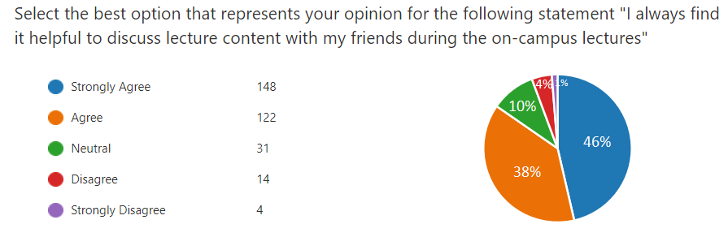
Objectives
Enabling collaborative learning
IT18001112
Tharaka
W.C.M.K.
Build a Virtual Learning Environment
Build character models for students
Implement collaborative content editing (Brainstorming, Mind Mapping etc.)
Reducing student isolation during online lectures
Implement Voice communication channel
between a few numbers of friends
Implement QA Discussion board
26

Slide 29
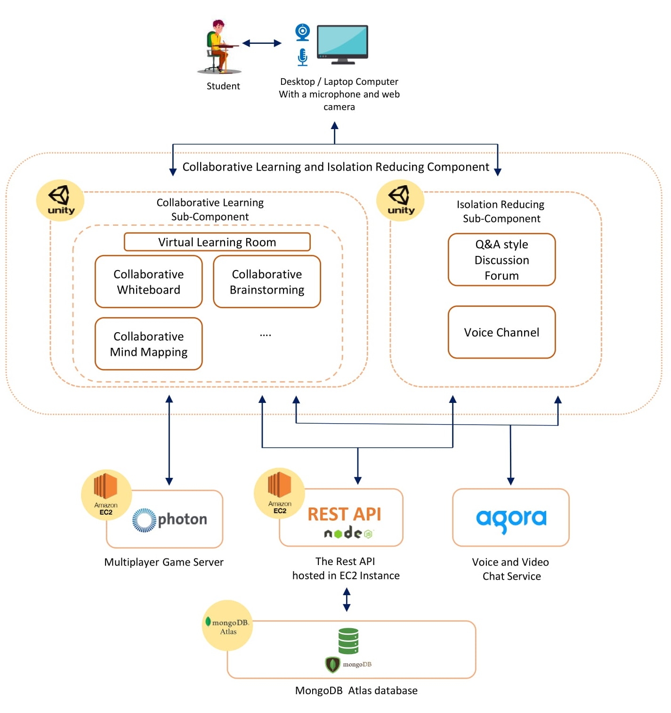
System Diagram and Technologies to be Used
IT18001112
Tharaka
W.C.M.K.
Unity Game Engine - Build the Virtual Environment
C# - Development language of Unity
Visual Studio IDE
Photon Unity Networking - Multiuser Development in Unity
Agora - Enable communication between users
Mongo DB Atlas - Database
Node.JS, Express.JS - REST API
AWS EC2 cloud service - Cloud Sever
27

Slide 30

System, Software and Personnel Requirements
IT18001112
Functional Requirements of the Component
Tharaka
W.C.M.K.
Students communicate when they use Virtual Learning Environment
Students modify contents collaboratively in the Virtual Learning Environment
Students use QA discussion forum during the lectures
Students use voice channel during the lectures
Non-Functional Requirements of the Component
Availability
Reusability
Usability
Modifiability
28

Slide 31
System, Software and Personnel Requirements Contd.
IT18001112
Resource Personnel for Development
Tharaka
W.C.M.K.
Mr. Ranga Pushpakumara – Founder, CEO at Heladev Studios
Mr. Nilupul Senadheera – Senior Software Engineer at Layer 7 Innovations Inc.
29

Slide 32
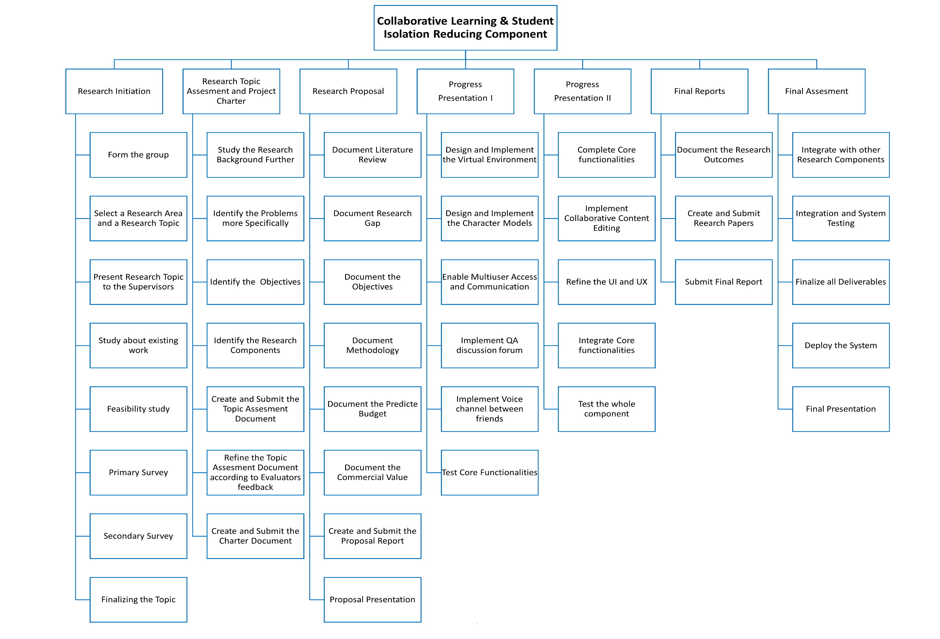
Work Breakdown Structure
IT18001112
Tharaka
W.C.M.K.
30

Slide 33
Gantt Chart
IT18001112
Tharaka
W.C.M.K.
31

Slide 34

Budget
Component | Amount (USD) | Amount (LKR)
AWS Cloud | 20 | 3,920
Internet Cost | 10.21 | 2000
Total Cost | 30.21 | 5920
IT18001112
Tharaka
W.C.M.K.
32

Slide 35
References
[1] A.Sfard, “On Two Metaphors for Learning and the Dangers of Choosing Just One,”
Educ. Res., vol. 27, no. 2, p. 4, 1998, doi: 10.2307/1176193.
IT18001112
Tharaka
W.C.M.K.
[2] M. Laal and S. M. Ghodsi, "Benefits of collaborative learning," in Procedia -
Social and Behavioral Sciences, Jan. 2012, vol. 31, pp. 486–490, doi:
10.1016/j.sbspro.2011.12.091.
[3] "10 Biggest Disadvantages of E-Learning | E-Student", E-student.org, 2019.
[Online]. Available: https://e-student.org/disadvantages-of-e-learning/. [Accessed:
26- Feb- 2021]
[4] N. H. S. England, "10 stress busters," 2018. [Online]. Available:
https://www.nhs.uk/conditions/stress-anxiety-depression/reduce-stress/. [Accessed
Jan. 06, 2021].
[5] S. Lim, D. Coetzee, B. Hartmann, A. Fox, and M. A. Hearst, "Initial experiences
with small group discussions in MOOCs," L@S 2014 - Proc. 1st ACM Conf. Learn.
Scale, pp. 151–152, 2014, doi: 10.1145/2556325.2567854.
33
[6] D. Coetzee, A. Fox, M. A. Hearst, and B. Hartmann, "Chatrooms in MOOCs: All
talk and no action," 2014, doi: 10.1145/2556325.2566242.

Slide 36
SUB OBJECTIVE - 03
Providing a near-real time, simulated student behavioral view of the students
34

Slide 37
IT18009132
Dilanka R.M.T.
B.Sc. (Hons) Degree in Information Technology Specialization in Software Engineering
35

Slide 38

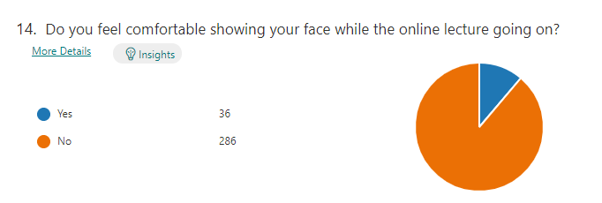
Background and Research Gap
IT18009132
students are reluctant to expose their faces and backgrounds to the other attendees during the online lecture
Dilanka R.M.T.
88%
lecturer cannot see the students' live reactions and engagement
Feel less motivation
Maintaining students’ attention is more challenging
36
Observe all the student behaviours in a screen is not practical

Slide 39
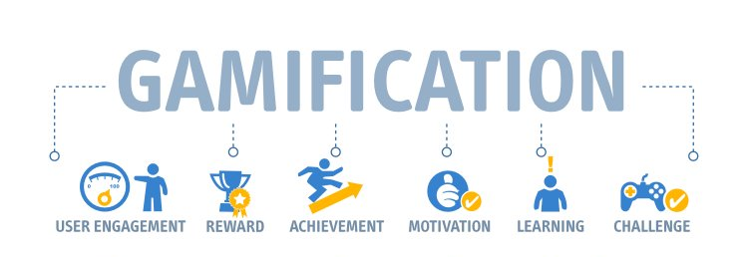
Background and Research Gap
IT18009132
Apply Gamification Concepts to online teaching
Dilanka R.M.T.
37

Slide 40

Research Problem
IT18009132
Providing the feature for the lecturers to observe the live behavior of the students while protecting the privacy
Dilanka R.M.T.
38

Slide 41
Research Question
IT18009132
How to use Gamification concepts in online teaching
Dilanka R.M.T.
How to create the experience of a real classroom for lecturers
How to enable separate voice channels between group of students
39

Slide 42
Objectives
IT18009132
Providing a near-real time, simulated students' behavioral view to the lecturer
Dilanka R.M.T.
Build the Virtual Class Room Environment
Build Student Representational Models With Facial Expressions and Behaviours
Capture Students’ Hand Gestures
Enable separate voice communication between lecturer and selected student group
40

Slide 43
System, Software and Personnel Requirements
IT18009132
Functional Requirements
Dilanka R.M.T.
Virtual classroom with near real-time student behaviours
Attentiveness of each student and Overall class room status
Lecturer should notify if most students got confused at a point
Student engagement report though out the lecturer
Non-Functional Requirements
Availability
Reusability
Scalability
Useability
41

Slide 44
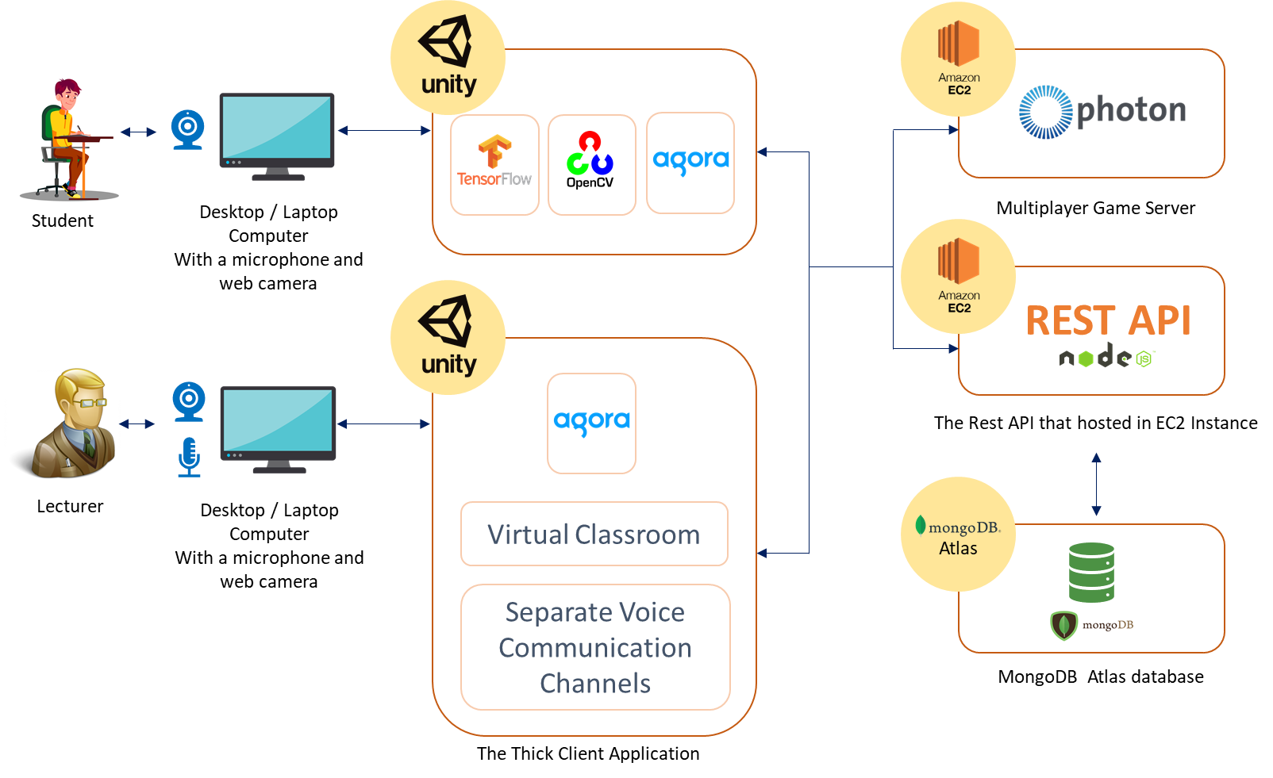
System Overview Diagram
IT18009132
Dilanka R.M.T.
42

Slide 45
Technologies to be Used
IT18009132
Unity Game Engine - Build the Virtual Environment
Dilanka R.M.T.
C# - Development language of Unity
Visual Studio IDE
Photon Unity Networking - Multiuser Development in Unity
Agora - Enable voice communication between lecturer and students
Mongo DB Atlas - Database
Node.JS, Express.JS - REST API
AWS EC2 cloud service - Cloud Sever
43

Slide 46
Work Breakdown Structure
IT18009132
Dilanka R.M.T.
44

Slide 47
Gantt Chart
IT18009132
Dilanka R.M.T.
45

Slide 48
Budget
Component | Amount (USD) | Amount (LKR)
AWS Cloud | 25 | 4900
Internet Cost | 22.96 | 4500
Total Cost | 47.96 | 9400
IT18009132
Dilanka R.M.T.
46

Slide 49
References
[1] Titan, Ferdianto, G. G. F. P. Desak and Lena, "A comparative study of teaching styles in online learning environment," 2017 International Conference on Information Management and Technology (ICIMTech), Special Region of Yogyakarta, Indonesia, 2017, pp. 25-30, doi: 10.1109/ICIMTech.2017.8273505.
[2] D. Preuveneers and W. Joosen, "Edge-Based and Privacy-Preserving Multi-Modal Monitoring of Student Engagement in Online Learning Environments," 2019 IEEE International Conference on Edge Computing (EDGE), Milan, Italy, 2019, pp. 18-20, doi: 10.1109/EDGE.2019.00017.
[3] M. Atherton, M. Shah, J. Vazquez, Z. Griffiths, B. Jackson, and C. Burgess, “Using learning analytics to assess student engagement and academic outcomes in open access enabling programmes,” Open Learning: The Journal of Open, Distance and e-Learning, vol. 32, no. 2, pp. 119–136, 2017
[4] W. S. Yue, "Enhancement of Learning Management System (LMS) by serious game engine: Collaborative," 2015 4th International Conference on Interactive Digital Media (ICIDM), Bandung, Indonesia, 2015, pp. 1-5, doi: 10.1109/IDM.2015.7516323.
IT18009132
Dilanka R.M.T.
47

Slide 50
SUB OBJECTIVE - 04
Help students by providing well-organized lecture note using optimized lecture transcription and related visual figures of the lecture
48

Slide 51
IT18007848
Rathnayake R.H.C.S.
B.Sc. (Hons) Degree in Information Technology Specialization in Software Engineering
49

Slide 52
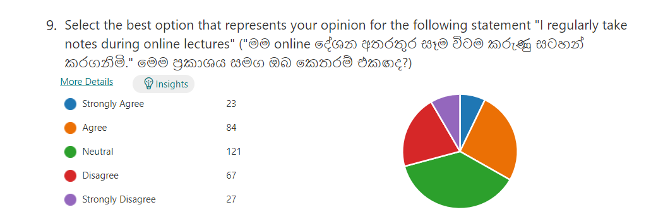
Background and Research Gap
IT18007848
Students are tended not to take lecture notes in online lectures
Rathnayake
R.H.C.S
There is no lecture note generation tool currently available in the
The E-learning domain
There is a limited number of researches of domain-specific training
on speech recognition models.
50

Slide 53
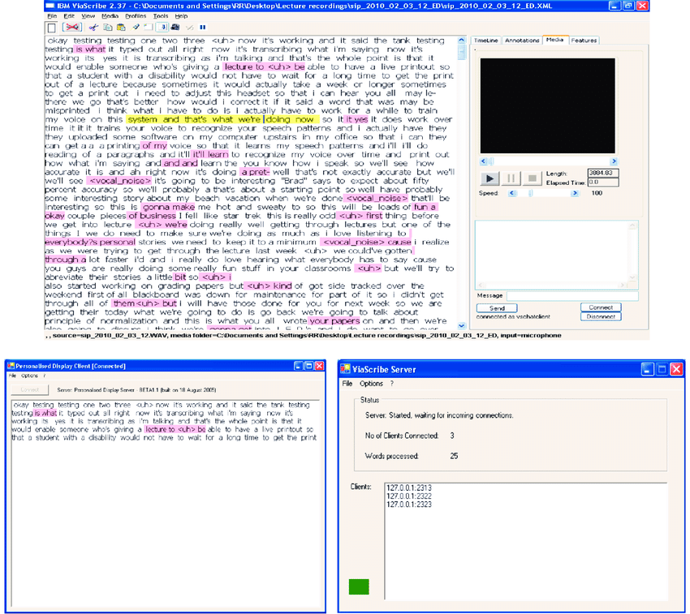
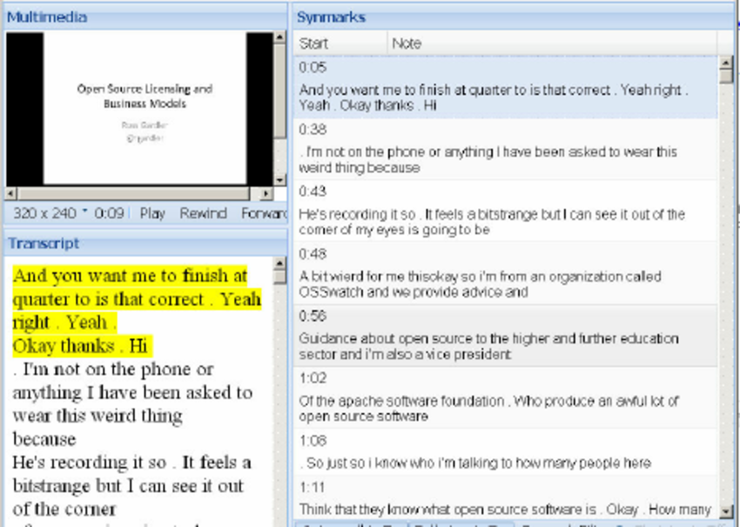
Existing Applications
IT18007848
IBM ViaScribe [4]
Synote [5]
Rathnayake
R.H.C.S
51

Slide 54
Research Question
IT18007848
How to help students with special needs to take an accurate lecture note ?
[1],[2]
Rathnayake
R.H.C.S
How to provide a well-organized lecture note with important figures
of the conducted lecture ?
52

Slide 55
Objectives
IT18007848
Use of speech recognition model to transcribe and fine-tune the lecturer speech [1]
Rathnayake
R.H.C.S
Train an image recognition model to identify the visual figures of the lecture
and to extract important figures from the lecture slides [3]
Organize the optimized lecture transcription with related visual figures
in order to generate a lecture note.
53

Slide 56
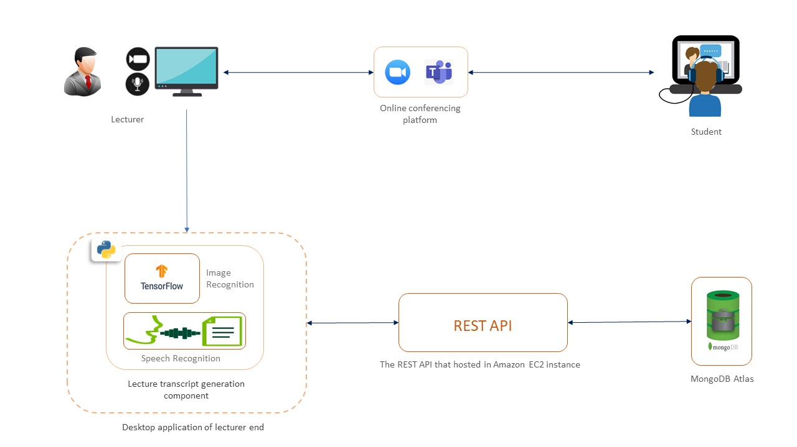
System Diagram for lecturer note generator
IT18007848
Rathnayake
R.H.C.S
54

Slide 57

Technologies to be used
Mozilla deep speech as a speech recognition engine
IT18007848
TensorFlow for image recognition
Rathnayake
R.H.C.S
Open CV
Google Collab – to gain computation power to train the speech recognition model
and image recognition model
Node JS, Express JS
MongoDB
Amazon web services
55

Slide 58
System, Software and Personnel Requirements
IT18007848
System Functional Requirements of the Project
Rathnayake
R.H.C.S
Support for real time transcription of lecturer speech to into text
Should be able to identify and extract important figures in the lecture slides
Should be able to detect when lecture slides or visual figures are changing
Should be able to deliver well organized lecture note at the end
System Functional Requirements of the Project
Availability
Reusability
Usability
56

Slide 59
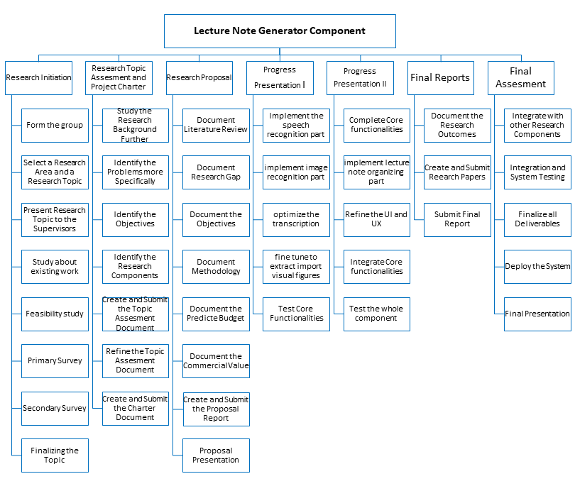
Work Breakdown Structure
IT18007848
Rathnayake
R.H.C.S
57

Slide 60
Gantt Chart
IT18007848
Rathnayake
R.H.C.S
58

Slide 61
Budget
Component | Amount (USD) | Amount (LKR)
Internet Cost | 10.21 | 2000
Total Cost | 10.21 | 2000
IT18007848
Rathnayake
R.H.C.S
59

Slide 62
References
[1] Ranchal, Rohit & Doughty, Teresa & Guo, Yiren & Bain, Keith & Martin, Heather &
Robinson, Joseph & Duerstock, Bradley. (2013). Using Speech Recognition for
Real-Time Captioning and Lecture Transcription in the Classroom. Learning Technologies,
IEEE Transactions on. 6. 299-311. 10.1109/TLT.2013.21.
IT18007848
Rathnayake
R.H.C.S
[2]Boyle, Joseph & Forchelli, Gina & Cariss, Kaitlyn. (2015). Note-Taking Interventions to Assist Students With Disabilities in Content Area Classes. Preventing School Failure. 1-10. 10.1080/1045988X.2014.903463.
[3]Wiley, J. Picture this! Effects of photographs, diagrams, animations, and sketching on learning and beliefs about learning from a geoscience text. Appl Cognit Psychol. 2019; 33: 9– 19. https://doi.org/10.1002/acp.3495
[4]Wald, M. (n.d.). Using Automatic Speech Recognition to Enhance Education for All Students: Turning a Vision into Reality. Proceedings Frontiers in Education 35th Annual Conference. doi:10.1109/fie.2005.1612286
[5]Wald, M., & Li, Y. (2012). Synote: Important Enhancements to Learning with Recorded Lectures. 2012 IEEE 12th International Conference on Advanced Learning Technologies. doi:10.1109/icalt.2012.8
60

Slide 63
Marketing Commercialization Plan Outline
61

Slide 64

Marketing Commercialization Plan
Targeted Audience
IT18006544
Perera H.D.D.S
Educational Institutes
Users: Lecturers and Students
Benefits
Students’ attention can be identified even if the student does not expose their identity to the lecturer
No need of using many tools to do collaborative learning
Students who are doing jobs with education will be able to save their time
Can help students who have hearing and physical impairments
62
Other existing solutions does not provide lecture note feature

Slide 65
Marketing Commercialization Plan
Advertising and Communication
IT18006544
Perera H.D.D.S
YouTube Channel
Facebook Page
Social Media Advertisements
63

Slide 66
Pricing Strategy
IT18006544
Student Attention level Detecting Tool
Virtual Classroom View With Attention Level Indicator
Student Attention level Detecting Tool
Virtual Classroom View With Attention Level Indicator
Attention Level Notification
Lecture Note Tool
Student Attention level Detecting Tool
Virtual Classroom View With Attention Level Indicator
Lecture Engagement Report
Attention Level Notification
Collaborative Learning Room
Lecture Note Tool
Perera H.D.D.S
Free
Standard
Premium
64

Slide 67

THANK YOU!

